Slide 1
WORK CASE 6
Мірошніченко А., Михальов В.

Slide 2
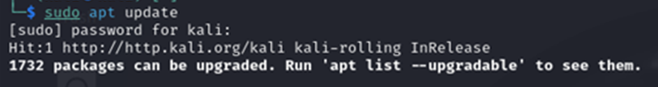
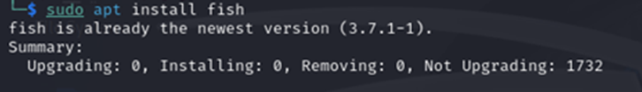
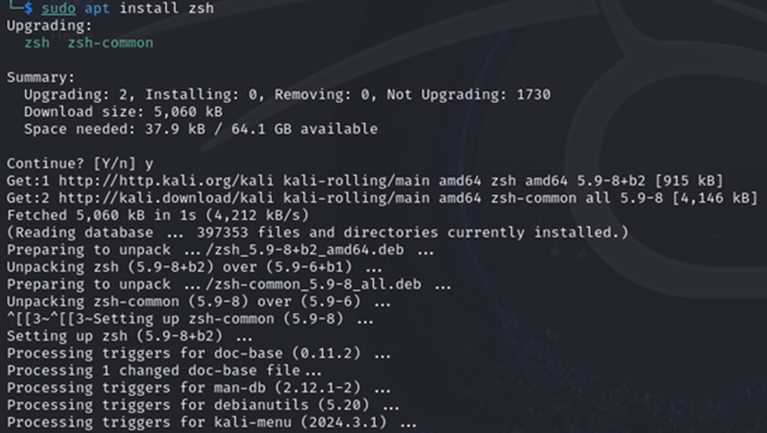
Installing multiple shell scripts
Fish (Friendly Interactive Shell) highlights syntax errors in commands. It offers interactive autocompletion with suggestions and documentation. It requires minimal configuration, allowing you to install and start working immediately.
Zsh (Z Shell) is a shell that supports many plugins and themes through Oh My Zsh. It features autocompletion for commands, files, and directories, and offers numerous options for customizing the working environment.

Slide 3
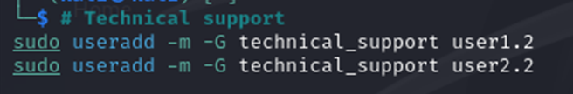
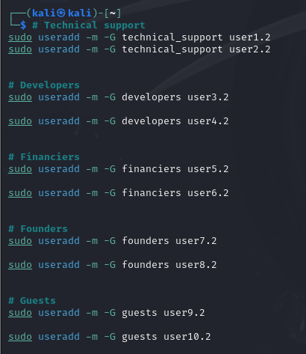
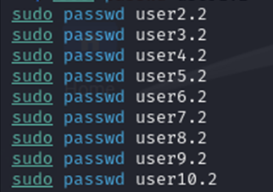
Technical support
Founders
Financiers
NEW USERS
Developers
Guests

Slide 4
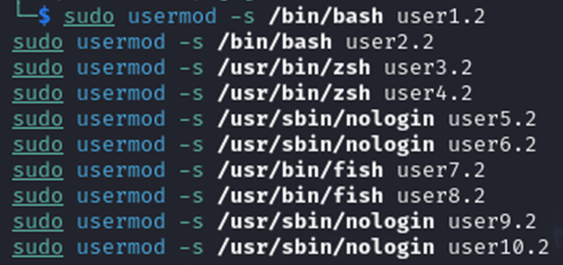
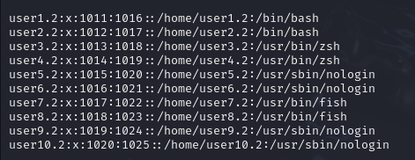
Default command interpreter for new users

Slide 5
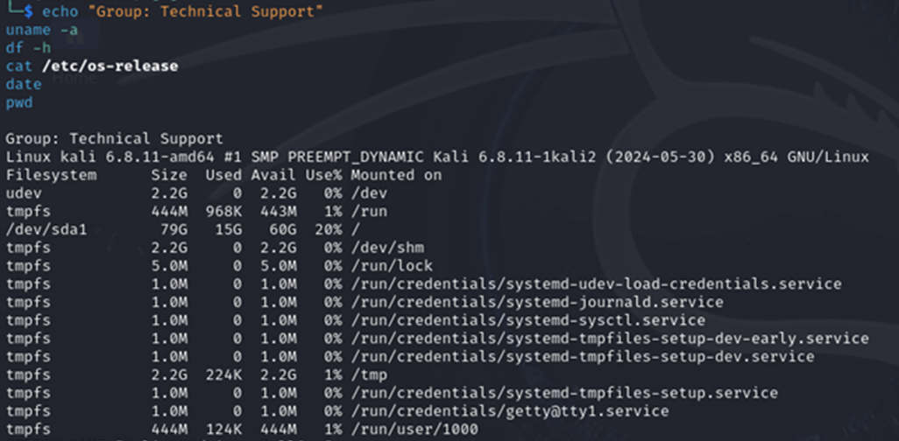
Examples of how each user group works in the command interpreter

Slide 6
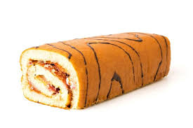
THANK YOU

